Slide 1
Unit Tests for Backend
Fabio Ono Tavoloni - 2019

Slide 2
Agenda
Why Test?
Types of Tests
Benefits
Fundamentals Conventions & Characteristics
Test First vs Model First
Mocking External Dependencies
TDD

Slide 3
Why Test?

Slide 4

Project Mariner I
https://www.youtube.com/watch?time_continue=45&v=VjJgiDuHlRw

Slide 5
What is Automated Test?
“Writing code to test our code, and then run them in an automated manner”

Slide 6
Benefits of Automated Testing
Test a good amount of features in less time
Catch bugs before deploying
Deploy with more accuracy
Focus more on the quality
Refactor with confidence
Program in a cleaner and maintainable manner
Safe $

Slide 7
Types of Tests
Unit Tests: you test the application without external dependences (database, WS, Files, MSMQ, AWS Services) – less cost/quickly
Integration Tests: test with external dependences (more cost, reliability)
E2E Tests: drives through UI (et. Selenium) – greatest confidence, slow, brittle

Slide 8
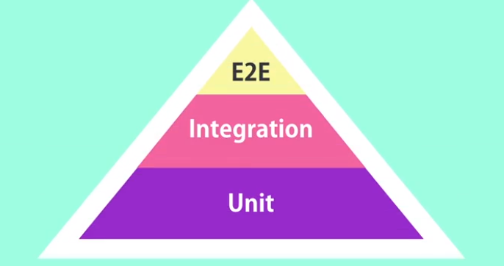
Test Pyramid

Slide 9
Characteristics of Good Unit Tests
Clean
Readable
Maintainable
No Logic
Isolated
No too specific, neither too general

Slide 10

Test First vs Model First
TDD is coming!

Slide 11
Let’s Code our First Unit Test!
https://github.com/fabioono25/UnitTestBackend

Slide 12
Conventions
Project Name: use the <project>.UnitTests / Tests.Unit
Try creating one Unit Test project per project
Try creating same folder structure
Naming the Test Class: <class>Tests
[TestFixture][SetUp][TearDown][Test] annotations
public void <method>_<scenario>_<expect>(){}
Triple A’s: Arrange/Act/Assert
Number of tests >= Number of execution paths
Focused on business rules

Slide 13
What to Test
Queries (return result)
Commands (change the state)
Public methods and Interfaces
Service classes
Domain objects
Helpers
Extension Methods
Mapping classes

Slide 14
Avoid to Test
Language features
3rd –party code
Middleware
Configuration
Private methods

Slide 15
Working with External Dependencies
“You Unit tests should not touch external resources (Integration Tests)”

Slide 16


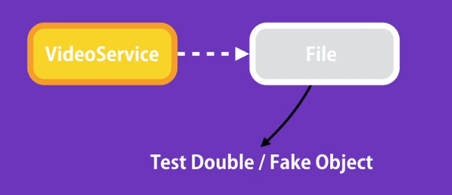
double!

Slide 17
How to Achieve a Loosely-Coupled Design
1º Extract the code that uses an external resource into a separate class
2º Extract an interface from that class
3º Modify the class to talk to the interface, instead of the concrete implementation
“Avoid the new in the class… program to interfaces… use Dependency Injection (via method parameters, properties or via constructor)”

Slide 18
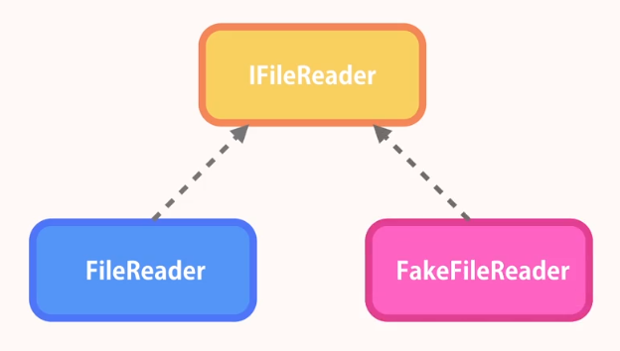
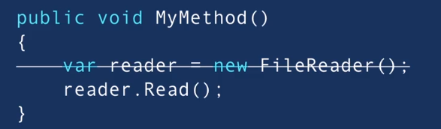
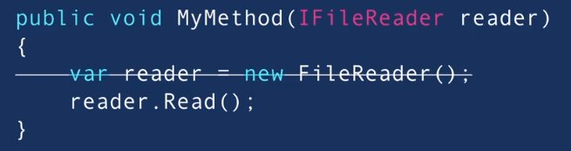

Slide 19
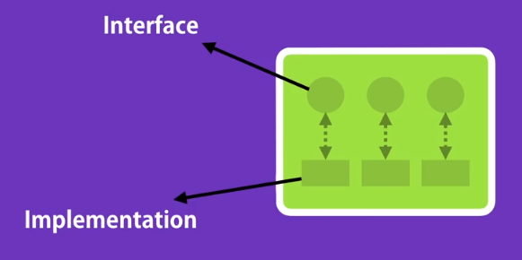
Dependence Injection Frameworks
Autofac
LightInject
Ninject
Unit
…

Slide 20
Mocking Frameworks
Moq
NSubstitute
FakeItEasy
Rhino Mocks
“Use mock framework only for external dependencies (avoid Fat Methods)”

Slide 21
Let’s Code Again

Slide 22

TDD came!

Slide 23
TDD (Test-driven Development)
“Write your tests before writing the production code”

Slide 24
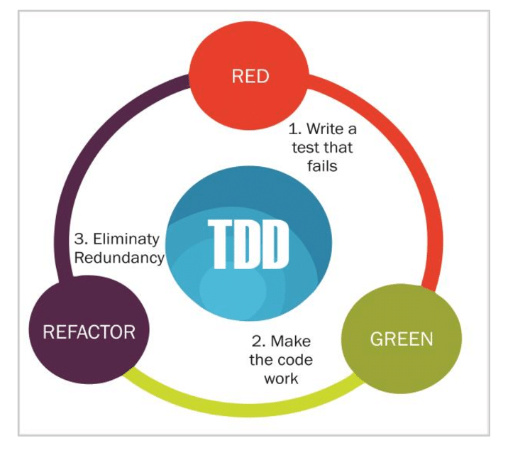
TDD Cycle

Slide 25
Benefits of TDD
Better understanding of the code
Testable source code
Full coverage by tests
Less redundancy
YAGNI approach (you ain't gonna need it) – simpler implementation
Tests are documentation
Create decoupled code

Slide 26
References
FSD Training Materials: http://wiki.fleetmatics.com/display/FFC/Training+Materials
Code Resources: https://github.com/fabioono25/UnitTestBackend
Test Pyramid (Martin Fowler): https://martinfowler.com/bliki/TestPyramid.html
IoC Container Benchmark: http://www.palmmedia.de/blog/2011/8/30/ioc-container-benchmark-performance-comparison
Moq Quick Start: https://github.com/Moq/moq4/wiki/Quickstart
FizzBuzz TDD Aproach (Jeremy Clark): https://www.youtube.com/watch?v=l4xhTq4qmC0
ReSharper: https://www.jetbrains.com/resharper/?fromMenu
DotCover: https://www.jetbrains.com/dotcover/?fromMenu
Visual Studio 2019 Community: https://visualstudio.microsoft.com/thank-you-downloading-visual-studio/?sku=community&ch=pre&rel=16
SOLID Principles & Some Patterns (Tim Corey): https://www.youtube.com/watch?v=5RwhyZnVRS8&list=PLLWMQd6PeGY3ob0Ga6vn1czFZfW6e-FLr
Unit Tests vs Integration Tests: https://www.softwaretestingclass.com/what-is-difference-between-unit-testing-and-integration-testing/
Dependency Injection (Tim Corey): https://www.youtube.com/watch?v=mCUNrRtVVWY
Clean Coder Videos (Uncle Bob): https://drive.google.com/drive/u/0/folders/12AXw5wHUavPXaXFZd6NTCcYGJd_Zdpxd
Unit Tests with C# (Mosh Hamedani): https://www.udemy.com/unit-testing-csharp/

